Slide 1
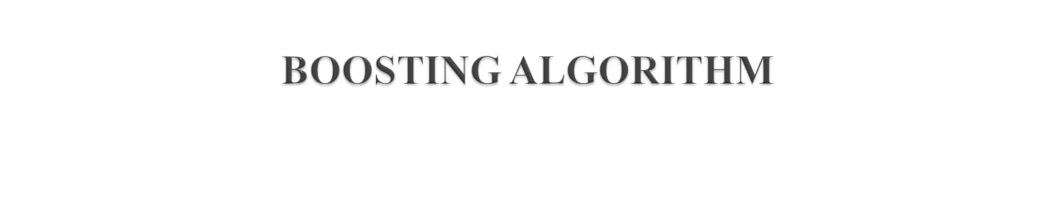
Boosting is a machine learning algorithm. That combines weak learners to create a strong learner. Which can improve the accuracy of regression and classification
And it’s types are
      AdaBoost
      LGBoost
      XGBoost

Slide 2
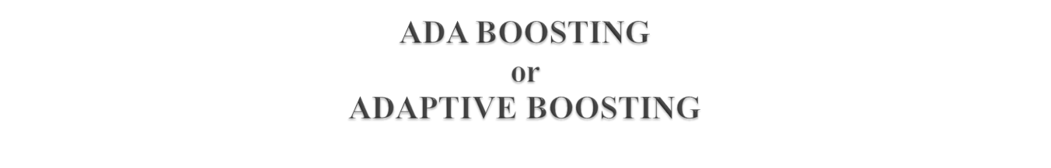
An AdaBoost regressor is a meta-estimator. That begins by fitting a regressor on the original dataset and then fits additional copies of the regressor on the same dataset . But where the weights of instances are adjusted according to the error of the current prediction.

Slide 3
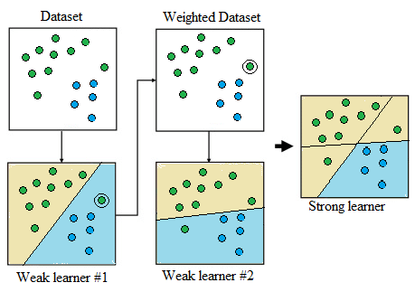

Slide 4
The above fig illustrates Methodology behind the AB algorithm on a data set that has two features and two classes.
Weak learner #2 improves on the mistake made by weak learner #1, such that the decision boundaries learnt by the two weak learners can be combined to form a strong learner.

Slide 5
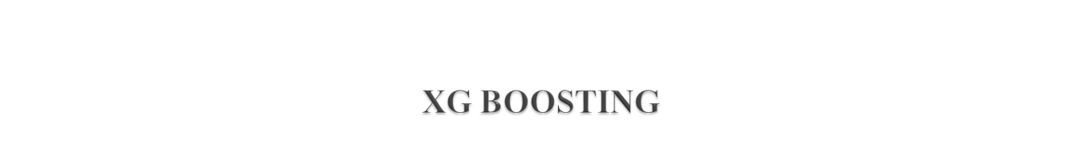
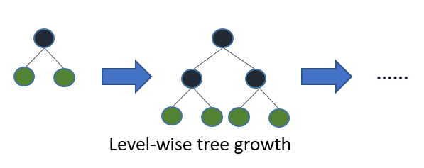
XGBM can perform parallel preprocessing of each node to save time and get rapid decisions/predictions . Extreme gradient boosting machines also understand the imputation (i.e. whether a node should be placed on the right or left of the decision tree) automatically.
In XGBoost, there is no need to find the missing data points, as they have the efficiency to decide where to put a node in the tree.

Slide 6
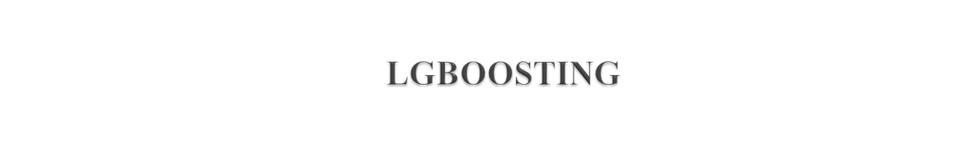
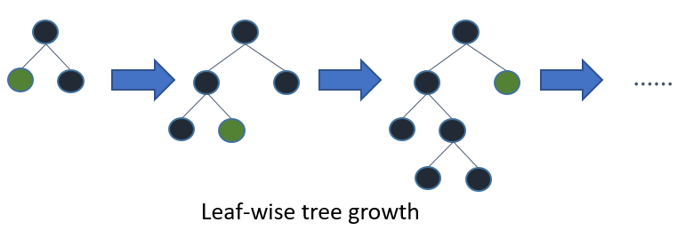
It is based on decision trees designed to improve model efficiency and reduce memory usage. Unlike XGBM, the light gradient boosting machine proceeds with respect to the leaf of the tree instead of the nodes.
To handle a large dataset, light GBM is quite an efficient approach. However, it does not perform well for small data points.

